Slide 1
Office Camp
September 2014

Slide 2
Course Agenda
Office Camp
Module 1: Introduction to the Day
Module 2: Setting up the Environments
Module 3: Hook into Apps for SharePoint
Module 4: Hook into Office 365 APIs
Module 5: Hook into Apps for Office

Slide 3
Introduction to the Day
Speaker
Speaker

Slide 4

Agenda
Introduction
High-Level Office 365 Development
Demo of all Samples in this DevCamp

Slide 5
Introduction

Slide 6
Module 2: Setting up the Environments
In order to do the hands-on-labs in the DevCamp, you need online “environments”
In this module you will create
Office 365 developer tenant
Microsoft Azure subscription
Both will be used throughout the labs.

Slide 7
Module 3: Hook into Apps for SharePoint
Understand creating cloud-hosted apps, aka: provider-hosted apps
Understand app security & permissions (OAuth2)
Understand the cross-domain library

Slide 8
Module 4: Hook into Office 365 and SharePoint APIs with SPAs
Understand creating SharePoint-hosted apps
Understand how to create single page applications (SPA) using AngularJS
Understand why and how to protect the OAuth2 access tokens with an intermediary

Slide 9
Module 5: Hook into Apps for Office
Understand how to create Apps for Office
Outlook Web App
Word Task Pane App

Slide 10
High-Level Office 365 Development

Slide 11
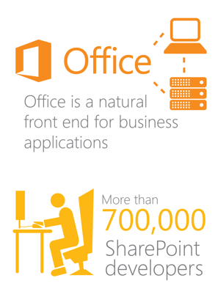
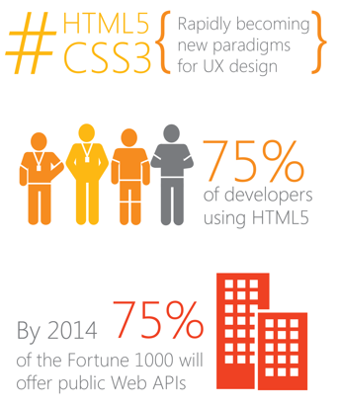
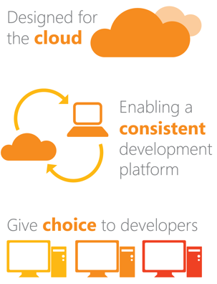
Our Vision: Modernizing the Platform
Today’s Market
Today’s Trends
Our Principles
Notes:
Keenan – 5 Minutes

Slide 12


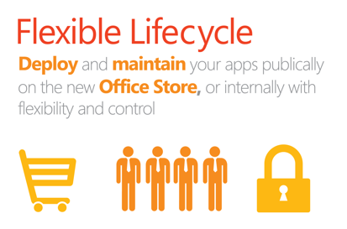
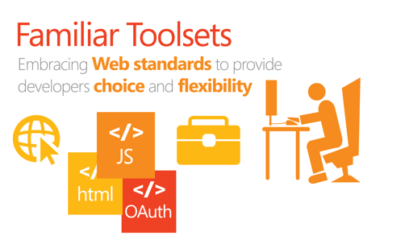
The Result: A new App Model and API
Notes:
Keenan – 5 minutes

Slide 13

What is in it for developers?
Same code works in cloud and in on-premises
Build market place apps and reach all Office 365 customers easily
More flexible model with additional possibilities
Standard .NET development tooling
Notes:
Let’s take a moment and, in a brief glimpse, look at what is in store for developers for Office and Office 365 development.

Slide 14
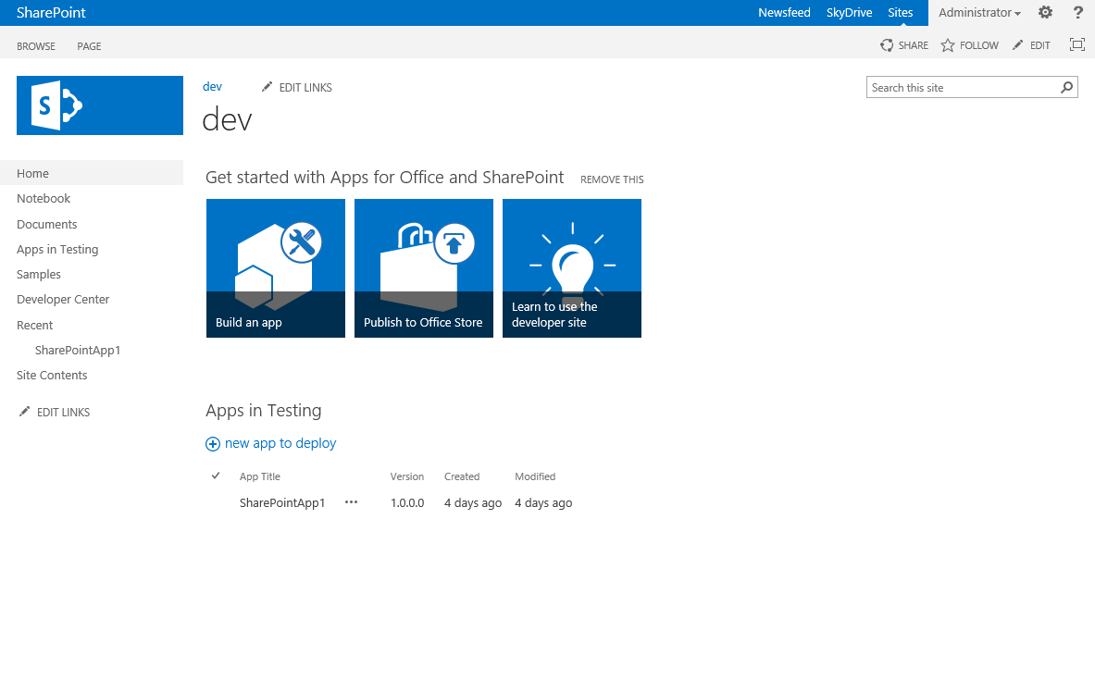
Developer template and usage
Enables remote development against the SharePoint farm
Also with on-premises deployments
Notes:
Microsoft created a new type of site collection template that developers can use when developing and testing apps. This new type of site, a Developer Site Collection, allows developers to install and attach a debugger to the app straight from Visual Studio.

Slide 15
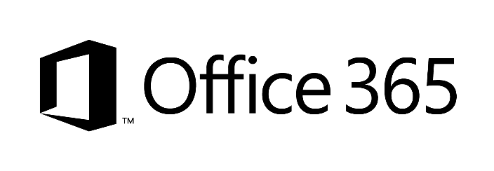









Developer sites and remote development
2
1
3
1
4
1
Notes:
Clients using remote development tools
Preferred option is to use Office365 – you can share even the same instance cross your App developers
You can also host your SharePoint Windows Azure IaaS server – so that development occurs against that instance
Just as for IaaS, you can do development against shared on-premises instance – most likely you’d dedicate site collection per developer for testing usage
TFS – could be on-premises, hosted in IaaS platform or used as service from cloud

Slide 16
App shapes for SharePoint
Full page
Implement complete app experiences to satisfy
business scenarios
Parts
Create app parts that can interact with the SharePoint experience
UI command extensions
Add new commands to the ribbon and item menus
Notes:
The new SharePoint App Model gives developers three different ways to surface their app customizations within SharePoint sites.
The first option, a full page, is required for all apps. Think of this as the immersive experience where you can create an app that takes over the entire screen.
Even if your app is designed to only use the App Part or UI command extension options (both explained in a moment), you must still have a full page implementation. However this can simply be an “about me” or FAQ style page for your app customizations.

Slide 17
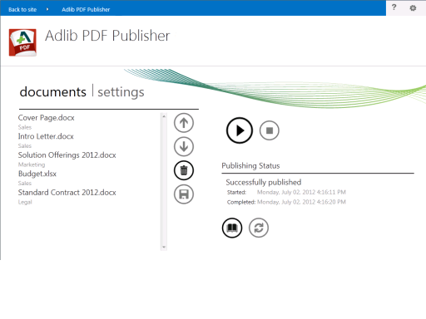
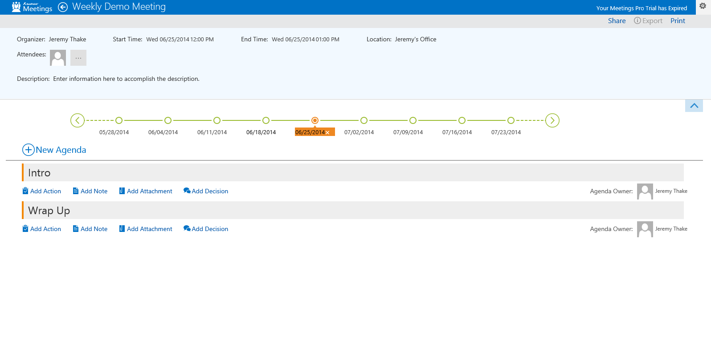
Notes:
This is an example of what the full page immersive experience would look like. Notice the traditional SharePoint experience is missing… all we see is a familiar SharePoint app bar at the top, but everything else is custom.
Microsoft does provide some controls & tools to ingest the parent site’s styles so that your app can have a similar look & feel as the parent site.

Slide 18
App shapes for SharePoint
Full page
Implement complete app experiences to satisfy business scenarios
Parts
Create app parts that can interact with the SharePoint experience
UI command extensions
Add new commands to the ribbon and item menus
Notes:
Another option for surfacing your customizations are app parts. To the end user, these look and act very much like web parts. However the content is rendered by your app that resides either in SharePoint or some remote location.

Slide 19
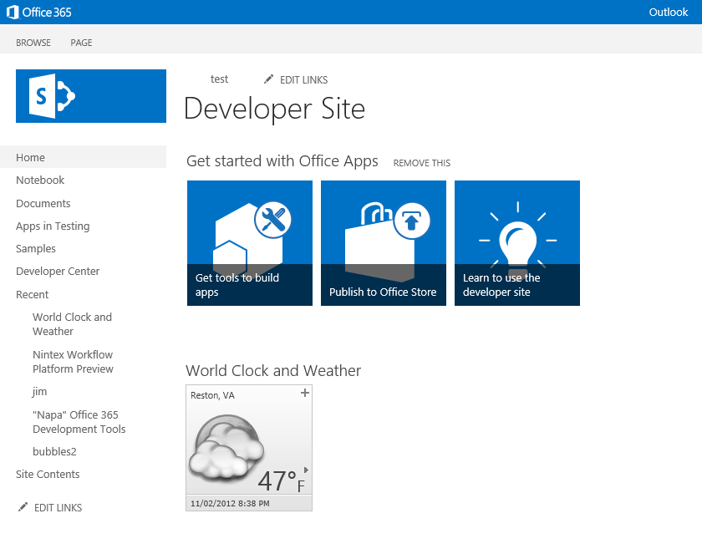
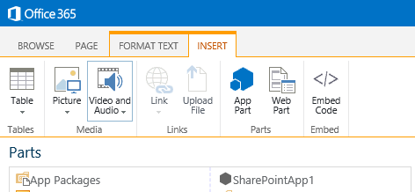
Notes:
Here is an example of an app part. Notice adding it to the existing page is very similar to adding a web part. When it’s rendered, it looks like a standard web part, as in the screenshot showing the weather for Reston, Virginia… except that content is actually coming from the app.

Slide 20
App shapes for SharePoint
Full page
Implement complete app experiences to satisfy business scenarios
Parts
Create app parts that can interact with the SharePoint experience
UI command extensions
Add new commands to the ribbon and item menus
Notes:
The final type of customization is a UI command extension. This can be implemented as a custom menu item in lists and libraries or as a new button or tab on in the ribbon.

Slide 21
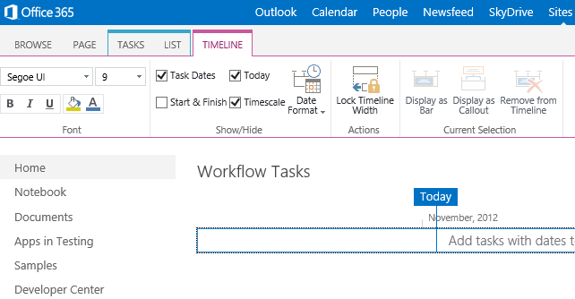
Notes:
Here is an example of a command UI extension. You see that this app has created a new tab in the ribbon called TIMELINE that contains it’s own tab groups and controls to interact with the page.

Slide 22
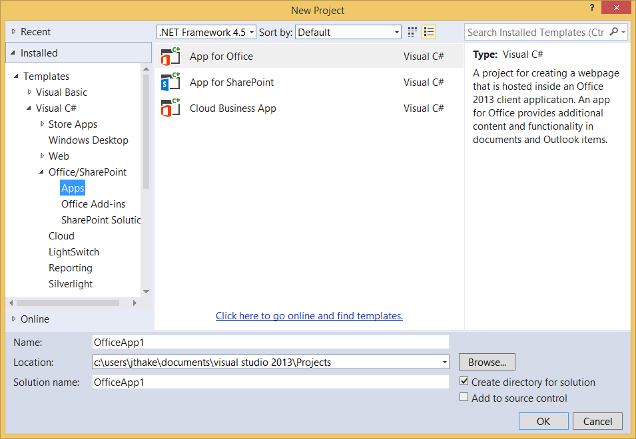
Visual Studio 2013
Notes:
Microsoft has made it very easy to get up to speed and start developing apps for Office 365 and SharePoint. Visual Studio 2013 ships with the Office Developer Tools already installed and configured. While they are shipping updates for new releases of the tools, you are good ot start creating apps right out of the gate.
The default tools allow you to create Apps for SharePoint, Office or if you are working on older versions of SharePoint deployments, you can also create solutions.
If you are using Visual Studio 2012, tools are also available as an extra download but may not have all the same capabilities as those in Visual Studio 2013.

Slide 23
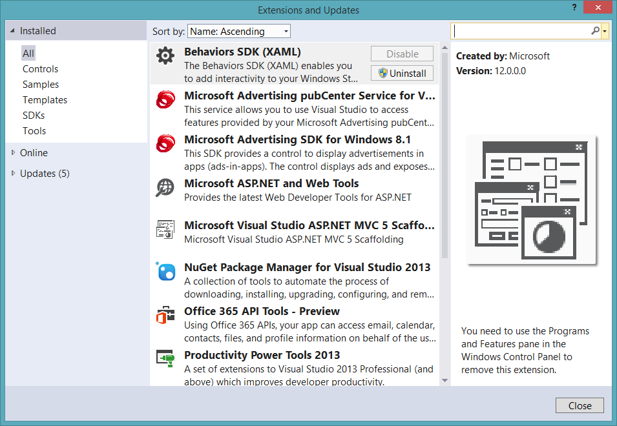
Office 365 API Tools - Preview
Notes:
In addition to the default tools, the Office team has a NuGet package for Visual Studio that installs additional tools for the Office 365 API as you can see here.

Slide 24
Developer Environments - Options
Office 365 developer tenant
Office 365 individual developer site collection
On-premises SharePoint server
Notes:
As a developer you have a few different options for your development environment. As previously explained, you will need a SharePoint site that you can test your solutions against. Microsoft recommends using the Developer Site Template and it can exist in either Office 365 or in an on-premises SharePoint deployment. Further, it’s recommended each developer have their own site collection they can do development, debugging and testing against… regardless if they are on-premises or using Office 365.
If you are only creating apps, Office 365 is the easiest solution as your development environment simply needs Visual Studio 2013 which can run on Windows 8.x.
However if you are going to be building solution, either farm solutions or sandboxed solutions, you will need a full SharePoint environment as Visual Studio can only deploy solutions and debug them when SharePoint is running locally on the same box as Visual Studio.

Slide 25
SharePoint client APIs
Lists and libraries
User profile
Search
Taxonomy
Feeds
…
http://[...]/[sharepoint site]/_api
Execute query
REST/ OData
JavaScript library (aka: JSOM)
Silverlight library
(aka: CSOM)
.NET CLR library
(aka: CSOM)
Custom client code
Notes:
This slide shows the primary ways your app will interact with Office 365 and SharePoint. There are two sets of APIs available to developers.
One option is a pure RESTful endpoint that is modeled & implemented following the OData protocol. This enables you to use any technology, any language hosted on any infrastructure to interact with SharePoint.
Another option is to use the client side object mode, also known as CSOM. The CSOM is proxy that calls the same endpoint but at times offers additional functionality not provided in the REST API. This proxy comes in three favors: a .NET CLR library, a Silverlight library and a third library used in client-side JavaScript solutions (also referred to as the JSOM).

Slide 26
Demo of all Samples in the DevCamp

Slide 27
demo
Module 2 – Setting up Developer Environments
Notes:
This demo is optional & up to the discretion of the presenter. See the demo script /demos/script-module02.md for instructions

Slide 28
demo
Module 3 – Hook into Apps for SHarePoint
Notes:
See the demo script /demos/script-module03.md for instructions
These demos show how to do simply OAuth2 programming & dealing with app permissions and identity as well as working with the cross domain library.
Focus on USING the deployed solution, not building it.

Slide 29
demo
Module 4 – Hook into Office 365, SharePoint-Hosted Apps & SPAs
Notes:
See the demo script /demos/script-module04.md for instructions
This demo shows the final solution built in module 4.
Focus on USING the deployed solution, not building it.

Slide 30
demo
Module 5 – Hook into Apps for Office
Notes:
See the demo script /demos/script-module05.md for instructions
This demo shows the final solution built in module 5.
Focus on USING the deployed solution, not building it.

Slide 31
Summary
Introduction
High-Level Office 365 Development
Demo of all Samples in this DevCamp

Slide 32

© 2012 Microsoft Corporation. All rights reserved. Microsoft, Windows, and other product names are or may be registered trademarks and/or trademarks in the U.S. and/or other countries.
The information herein is for informational purposes only and represents the current view of Microsoft Corporation as of the date of this presentation. Because Microsoft must respond to changing market conditions, it should not be interpreted to be a commitment on the part of Microsoft, and Microsoft cannot guarantee the accuracy of any information provided after the date of this presentation. MICROSOFT MAKES NO WARRANTIES, EXPRESS, IMPLIED OR STATUTORY, AS TO THE INFORMATION IN THIS PRESENTATION.

